Slide 1
Climate change effects on nectar characteristics
Audrey McCombs
EEB590 Final Presentation

Slide 2
Introduction
Question
Increased temps
Nectar characteristics
Volume
Sugar concentration
Sugar mass
Measuring
Nectar volume in μL
Important?
Critical resource for pollinators
Structure pollinator communities

Slide 3
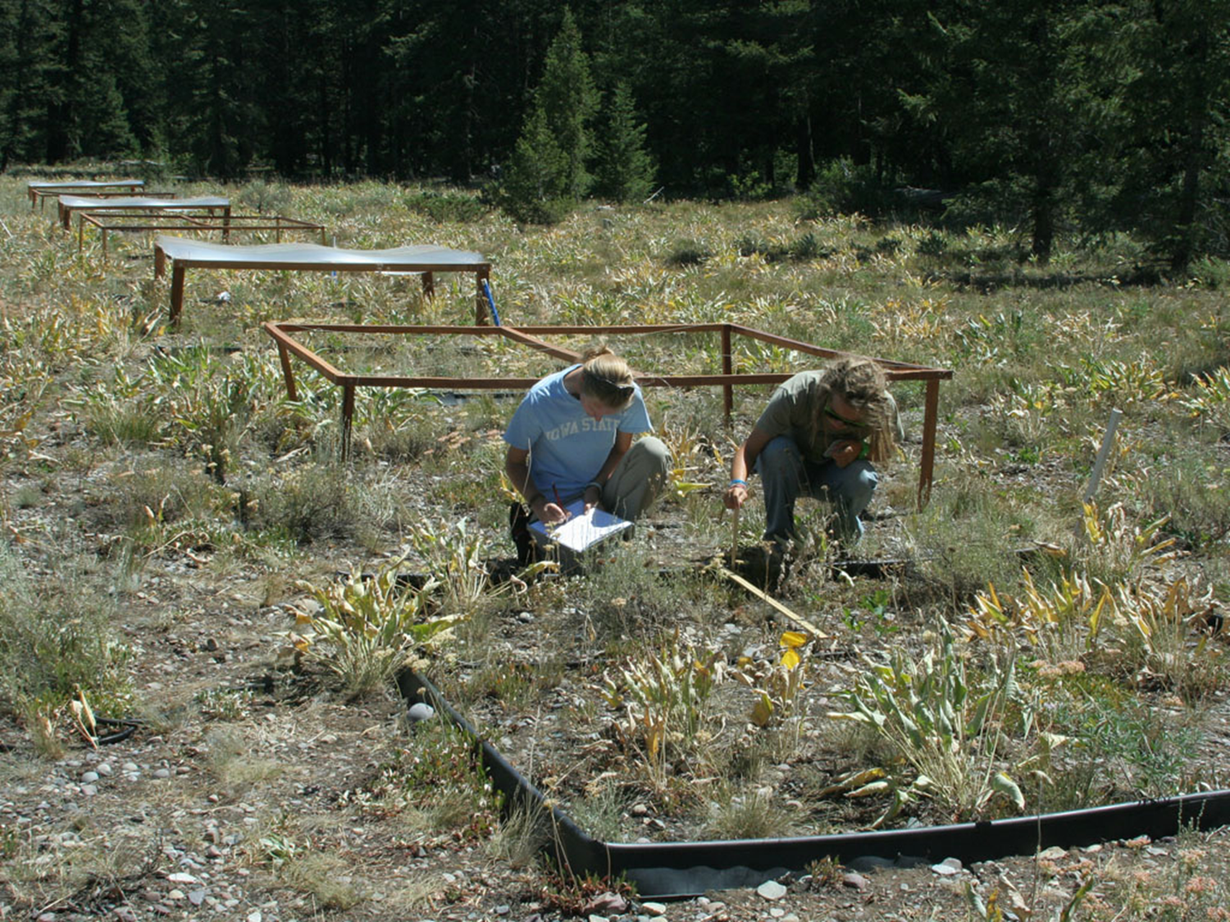
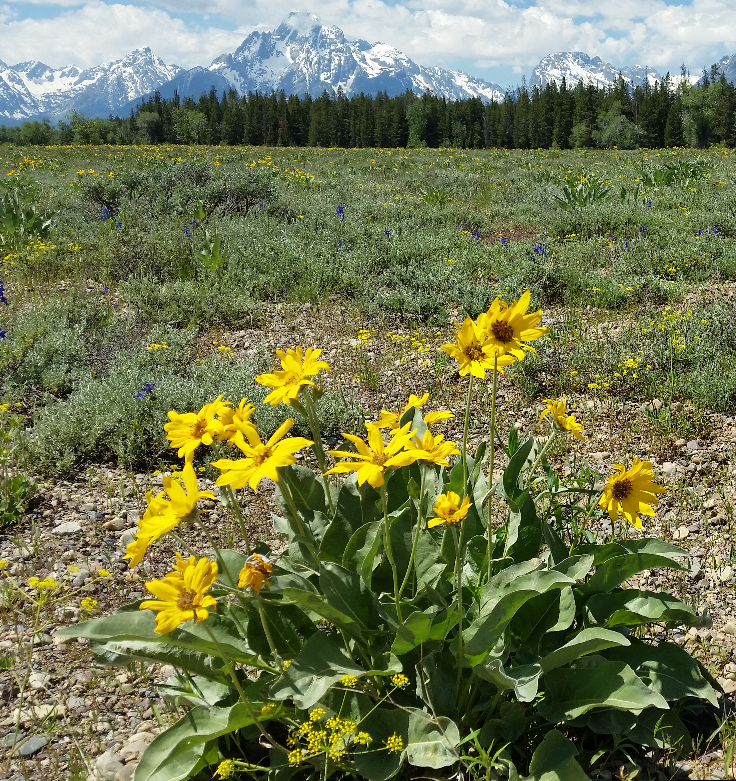
Picts

Slide 4

Plot layout
8’ square
1
3
5
7
9
11
H
C
2
1
4
6
8
10
12
3
2

Slide 5
Model
lmer(volume ~ treatment * year + (1|plot/plant))

Slide 6
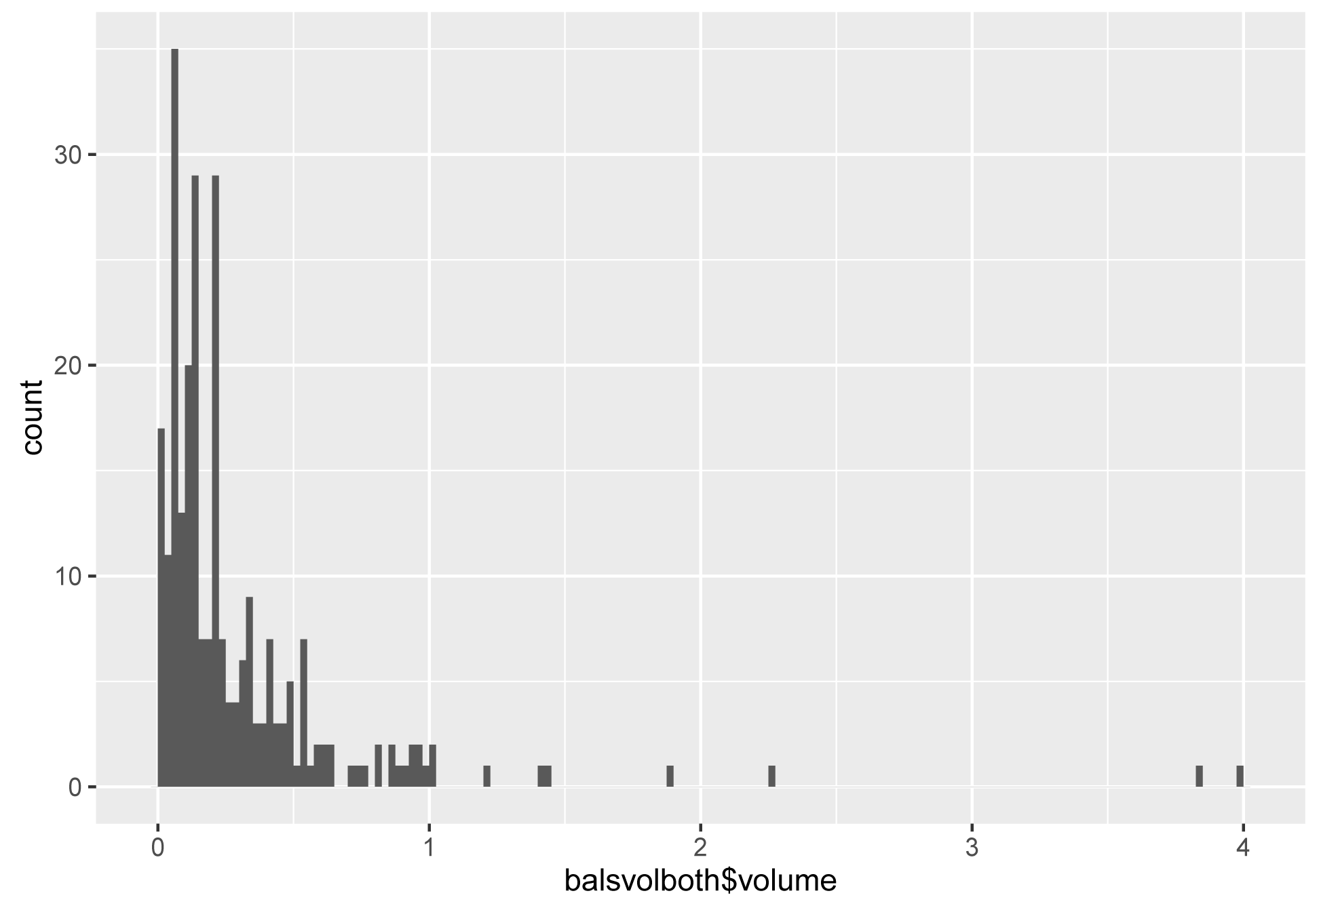
Data Exploration
Sample size
C: 116
H: 144
Min: 0.01818
Overall median: 0.1664
Overall mean: 0.29413
Max: 3.9818
Mean C: 0.29279
Mean H: 0.29520
Variance ratio (H/C): 1.2363

Slide 7
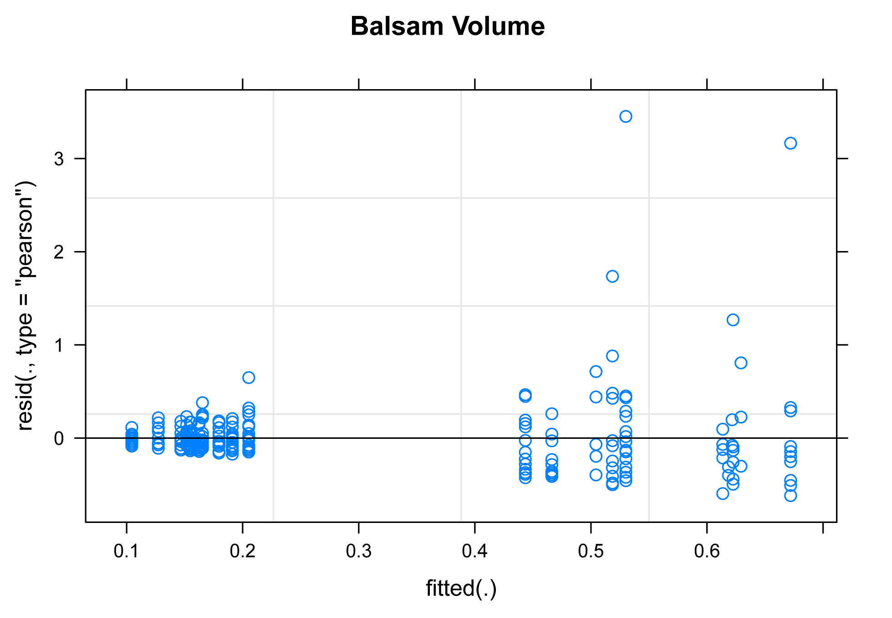
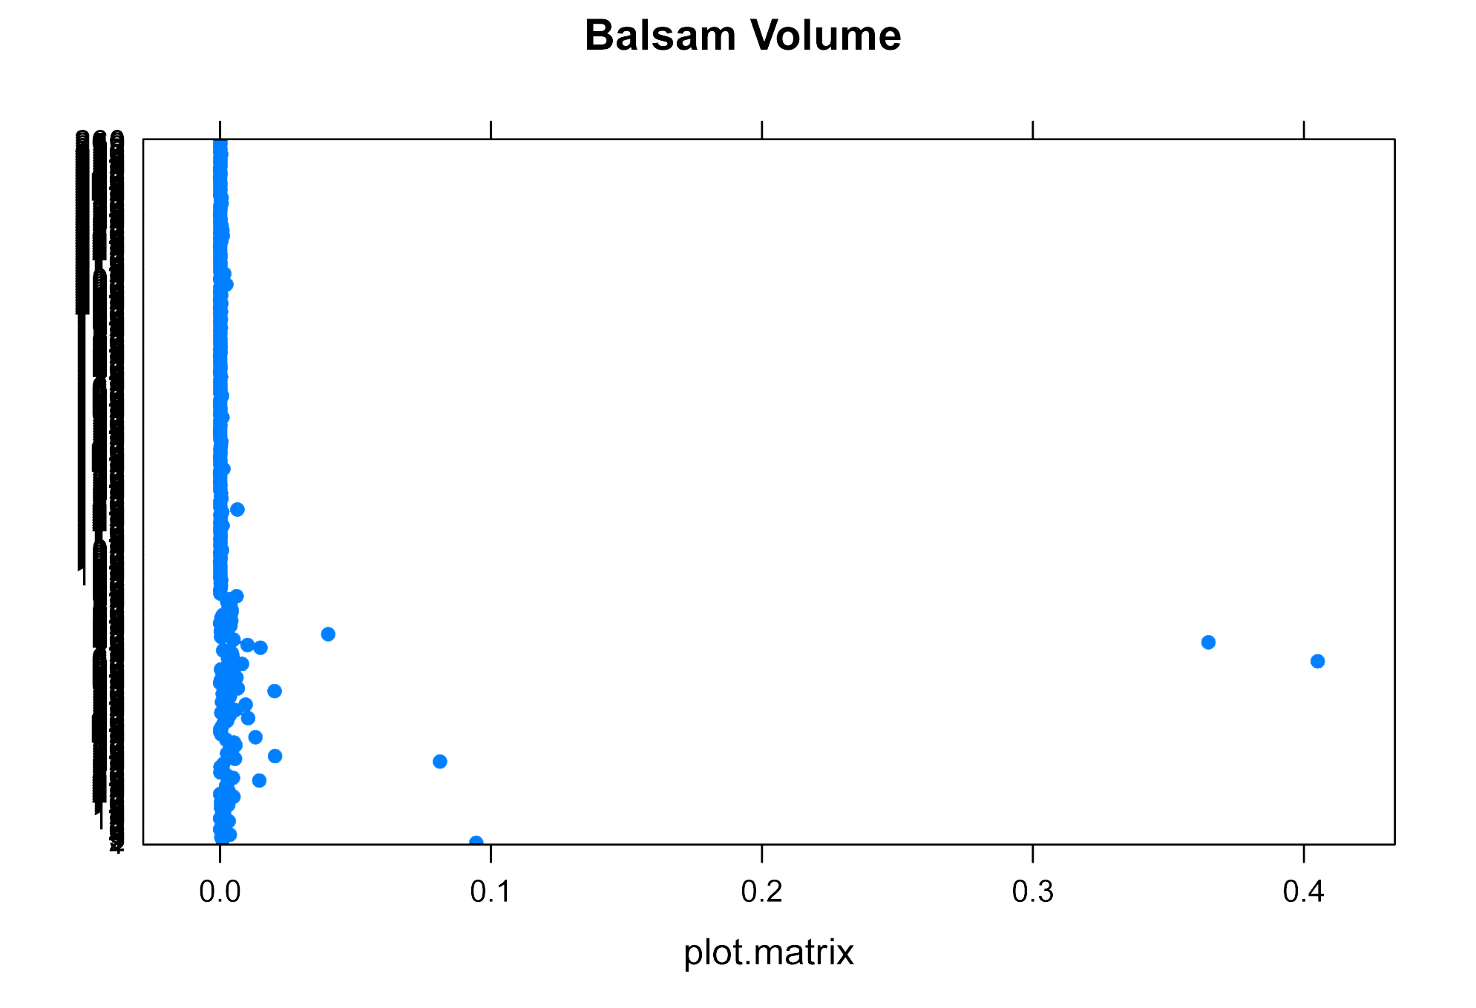
Diagnostics
Residuals
Cook’s Distance

Slide 8
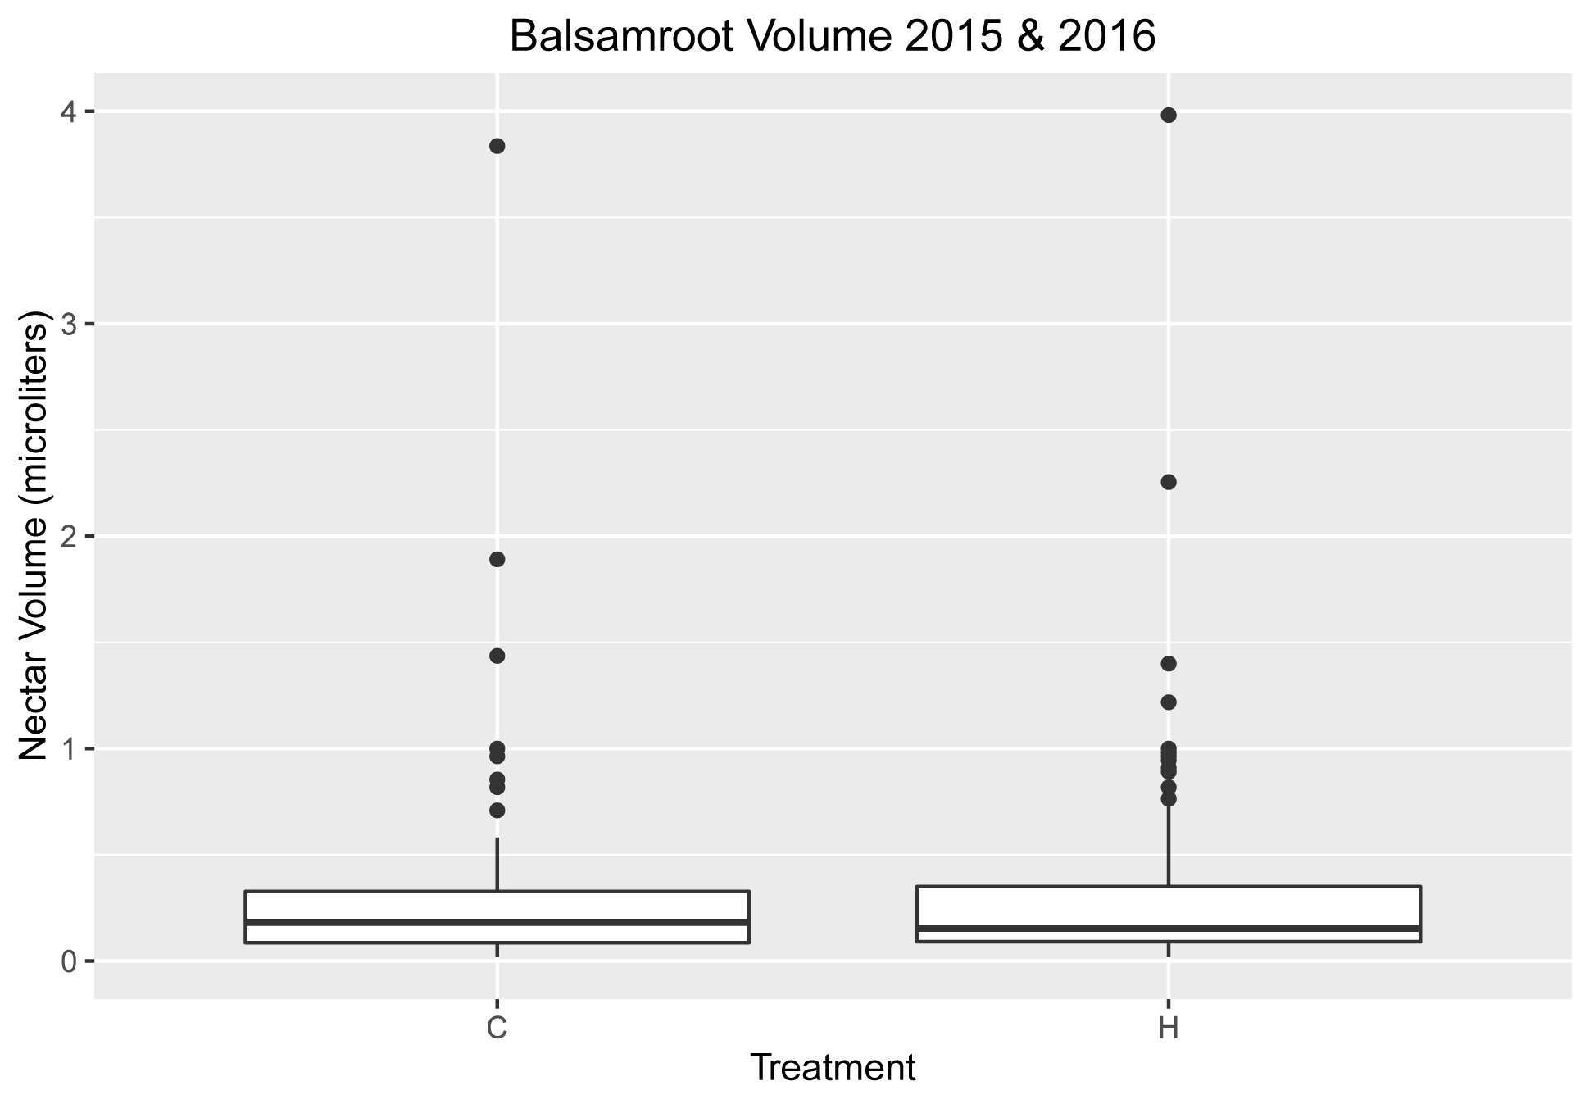
Results

Slide 9
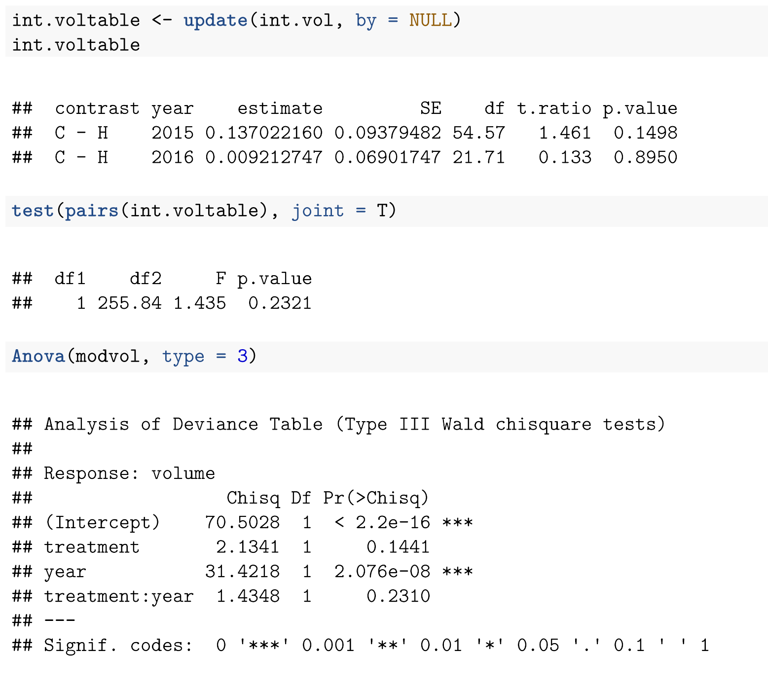
Results

Slide 10
Questions
Is the model right?
Did I do everything I needed to for data exploration?
Did I do everything I needed to for diagnostics?
What about transforming the data?

